Slide 1
Testing in React Unit Test, Integration Test, E2E Test
Presented by :Taki Eddine RAHAL

Slide 2

I. Introduction II. Tools and Dependencies III. Unit Testing IV. Integration Testing V. End-to-End Testing
Plan

Slide 3
I. Introduction

Slide 4
Introduction
Importance of Testing
Test if everything works as expected.
Helps identify bugs in the early stages of the development cycle
It saves time and money during the later testing phases
Making corrections and changes in the code is quick : When you have tests, you can change stuff without worrying about breaking things. This means you can add new features or tidy up the code with less stress.

Slide 5
Introduction
Importance of Testing
It is easy to onboard new team members in the development as they can also understand the code base with less effort. Moreover, any damage to the code becomes less worrisome as it can be quickly identified.
Unit testing facilitates changes to the code by providing a way to quickly and easily verify that changes to the code do not break existing functionality
Tests can serve as a code documentation

Slide 6
Introduction
What Not to Test
Actual Implementation
=> Let’s say you want to sort an array on the click of a button. There’s no need to test the actual sorting logic. You only test if the function was called and if the state changes are rendering correctly

Slide 7
Introduction
What Not to Test
2. Third Party libraries
=> If you are using any third party libraries (like Material UI, JS Library, SDK JS (MFP) …), no need to test those – they should already be tried and tested.…..

Slide 8


Introduction
Test FrontEnd
The Test frontend divided in two part
UI Test
- Logic Test

Slide 9
Introduction
Test Structured
Any test in React, no matter how complicated, follows this structure
- Render the component
- Get an element from the component and simulate any user interactions
- Write an assertion.

Slide 10
Introduction
Testing Best Practices
Utilize the Arrange-Act-Assert (AAA) pattern: Given-When-Then
=> The AAA pattern is a fundamental principle in testing that helps maintain clarity and organization in your test cases. Arrange sets the test, Act performs the action or interaction, and Assert verifies the expected outcome.

Slide 11
Introduction
Testing Best Practices
Utilize the Arrange-Act-Assert (AAA) pattern: Given-When-Then
test(‘Example Component renders correctly’, () => { // Arrange (Given) const { getByText } = render(<ExampleComponent />); // Act (When) const element = getByText(‘Hello, World!’); // Assert (Then) expect(element).toBeInTheDocument(); });

Slide 12
Introduction
Testing Best Practices
2. Utilize the Test components in isolation
Testing individual components ensures thorough examination without interference from other parts, making debugging more accessible and faster.
test(‘Incorrect way of testing multiple components’, () => {
const { getByText } = render(<ParentComponent />);
const childElement = getByText(‘Child Component’);
expect(childElement).toBeInTheDocument();
});
=> Bad practice: testing multiple components together

Slide 13
Introduction
Testing Best Practices
3. Mock external dependencies
If your component relies on external dependencies, such as API calls or modules, it’s best to mock them during testing to isolate the component’s behaviour.

Slide 14
Introduction
Testing Best Practices
3.1 Mock external dependencies
Tools like Jest provide mocking capabilities to help you easily mock dependencies.
import axios from ‘axios’;
jest.mock(‘axios’);
test(‘Component fetches data from API correctly’, async () => {
axios.get.mockResolvedValue({ data: ‘mocked data’ });
const { getByText } = render(<DataFetchingComponent />);
await waitFor(() => {
expect(getByText(‘Data: mocked data’)).toBeInTheDocument();
});
});

Slide 15
Introduction
Testing Best Practices
3.0 Mock external dependencies: jest.fn vs jest.spyOn
The only difference is that YOU CAN RESTORE ORIGINAL FUNCTION with jest.spyOn and you can't with jest.fn
export const welcomeUser = (name: string) => {
return `Hello, ${name}!`;
}

Slide 16
Introduction
Testing Best Practices
3.2 Mock function: jest.fn()
test('mock function with jest.fn', () => {
// Given
const originalResult = utils.welcomeUser('Alice');
expect(originalResult).toBe('Hello, Alice!');
// Mock
const myMockMethod = jest.fn(() => 'Mocked!'); // Replaces the original permanently
const resultMock = myMockMethod();
expect(resultMock).toBe('Mocked!');
})

Slide 17

Introduction
Testing Best Practices
3.3 Mock jest.spyOn()
test('mock function with jest.spyOn', () => {
// Given
const originalResult = utils.welcomeUser('Alice');
expect(originalResult).toBe('Hello, Alice!');
// Spy and mock
const spy = jest.spyOn(utils, 'welcomeUser').mockImplementation(() => 'Mocked!');
const mockedResult = utils.welcomeUser('Bob');
expect(mockedResult).toBe('Mocked!');
expect(spy).toHaveBeenCalledWith('Bob');
// Restore the original greet
spy.mockRestore();
const restoredResult = utils.welcomeUser('Charlie');
expect(restoredResult).toBe('Hello, Charlie!');
});

Slide 18
Introduction
Unit Tests vs Integration Tests vs E2E Tests
BeforeAll
Kent C Dodds, a well-known software engineer, once said that what is important is the value that testing provides to the business. He doesn't care about the distinctions between types of testing. The value of testing is that it catches bugs and ensures that tests fail when breaking changes are made.

Slide 19
Introduction
Unit Tests vs Integration Tests vs E2E Tests
Unit Tests
=> Write unit tests for individual components or functions to ensure they work as expected in isolation.
=> Unit tests focus on one small part of your app at a time : like a button or a message
=> A single piece of code in isolation at a time

Slide 20
Introduction
Unit Tests vs Integration Tests vs E2E Tests
2. Integration Tests
=> Write integration tests to ensure that different parts of your application work together correctly
=> Testing the interactions between the different components, i.e., how these components work together to create a specific functionality or workflow

Slide 21
Introduction
Unit Tests vs Integration
 | Unit Testing | Integration Testing
Objectives | Isolation : designed to run in isolation from the rest of the code base Verification of Functionality: verify that each unit of code performs its intended functionality correctly Early Detection of Defects: By catching and addressing defects at the unit level, developers can identify and fix issues early in the development process | Interaction Validation: validate that different components or units interact correctly and exchange data in accordance with the specified requirements. Error Detection: helps identify issues related to the integration of components, such as incorrect data flow, communication problems, or compatibility issues

Slide 22
Introduction
Unit Tests vs Integration
 | Unit Testing | Integration Testing
Scope | Isolation: Units should be tested in isolation to ensure that the test results are specific to the unit being tested. Fast Execution: Units should be quick to execute, enabling developers to run them frequently without causing significant delays in the development workflow. | Component Integration: Verifying the interactions between individual components. System Integration: Testing the integration of different subsystems or modules.

Slide 23
Introduction
Unit Test vs. Integration Test in React.js
Feature | Unit Test | Integration Test
Definition | Tests a small, isolated unit (e.g., a single function or component). | Tests multiple units working together (e.g., components interacting with APIs or Redux state).
Scope | Very narrow (single component or function). | Broader, covering multiple components or modules.
Dependencies | Mocked dependencies (e.g., API calls, database). | Uses real or mock APIs, databases, and stores.
Example | Testing a function or component or a hook alone | Testing form submission and API response handling.

Slide 24
Introduction
Unit Tests vs Integration Tests vs E2E Tests
3. E2E Tests
=> Write E2E tests to verify that the entire application works as expected from the user’s perspective
=> Testing your entire application flow — from the user's perspective — in a simulated browser.

Slide 25
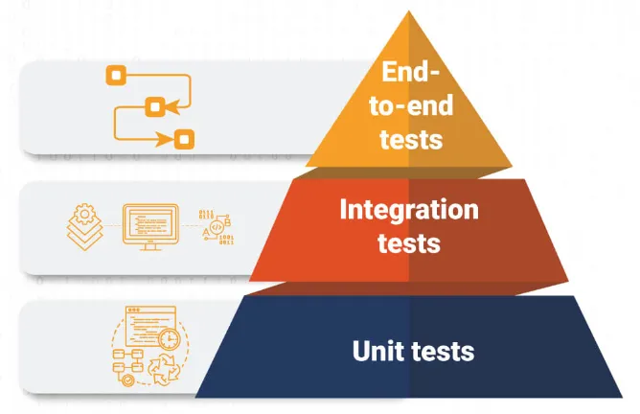
Introduction
Unit Tests vs Integration Tests vs E2E Tests

Slide 26
Introduction
Unit Tests vs Integration Tests vs E2E Tests
The testing pyramid constitutes three distinct levels. Unit tests are at the bottom level, while integration tests and end-to-end tests make up the middle and the top levels, respectively. You should have a lot of unit tests, some integration tests, and very few end-to-end tests in comparison to the other types

Slide 27
II. Tools and Dependencies

Slide 28

Tools and Dependencies
Jest
Jest is a delightful JavaScript Testing Framework with a focus on simplicity.
It works with projects using: Babel, TypeScript, Node, React, Angular, Vue and more!

Slide 29
Tools and Dependencies
Jest
Zero config
Jest aims to work out of the box, config free, on most JavaScript projects.
Fast and safe
By ensuring your tests have unique global state, Jest can reliably run tests in parallel. To make things quick, Jest runs previously failed tests first and re-organizes runs based on how long test files take.

Slide 30

Tools and Dependencies
Testing Library
Introduction
Is a light-weight solution for testing web pages by querying and interacting with DOM nodes (whether simulated with JSDOM/Jest or in the browser)
Helps you test React components in a way that's closer to how users interact with them (user event).

Slide 31
Tools and Dependencies
Installing Dependencies
npm install --save-dev jest @testing-library/react @testing-library/jest-dom or yarn add --dev jest @testing-library/react @testing-library/jest-dom

Slide 32

Tools and Dependencies
Cypress
Introduction
Watch your end-to-end and component tests run in real time as you develop your applications.

Slide 33
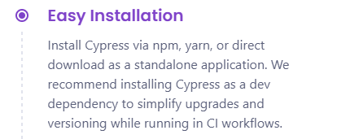
Tools and Dependencies
Cypress
Installing Cypress
npm install --save-dev cypress or yarn add --dev cypress

Slide 34
Tools and Dependencies
Cypress
Running Cypress
{ "scripts": { "cypress:open": "cypress open" } }

Slide 35
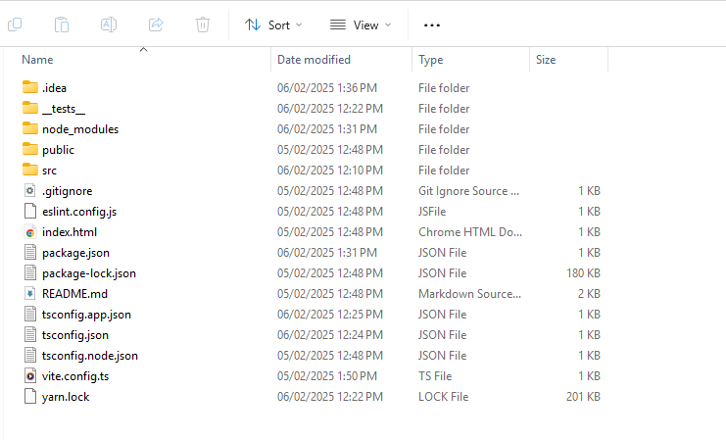
Tools and Dependencies
Cypress
Before Running Cypress

Slide 36
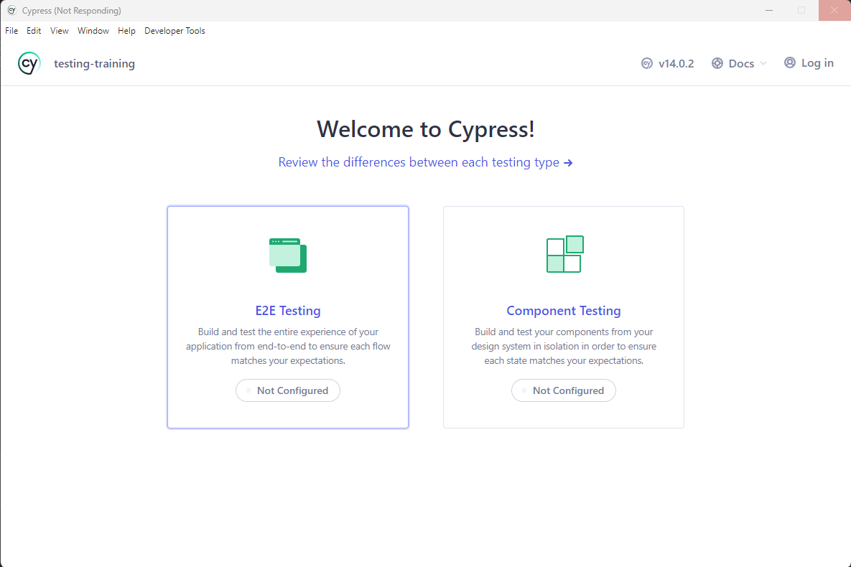
Tools and Dependencies
Cypress
After Running Cypress

Slide 37
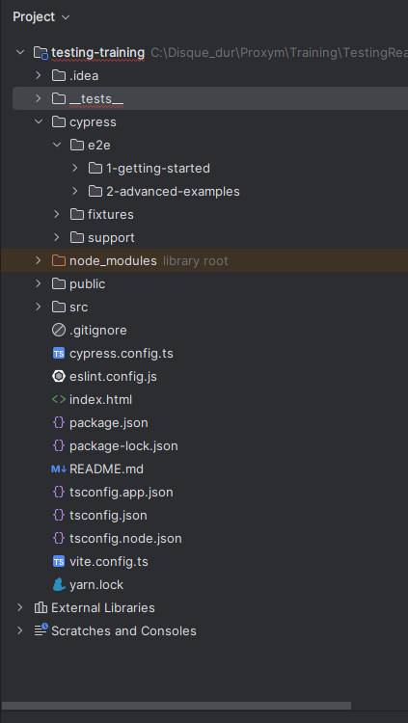
Tools and Dependencies
Cypress
After Running Cypress

Slide 38
III. Unit Testing

Slide 39
Unit Testing
Definition
Unit tests focus on one small part of your app at a time. They make sure that each little bit (like a button or a message, React component, a helper function, or any other JavaScript module ) works right on its own.

Slide 40
Unit Testing
What to test in Unit Testing
Component rendering: Ensure that the component renders correctly under different conditions.
State and props: Test the state changes and the props being received.
Event handling: Check if the events (like click, and input change) are handled correctly.
Lifecycle methods: Validate if the lifecycle methods are working as expected.

Slide 41
Unit Testing
How to perform Unit testing of React Apps using JEST?
Identify what to test: Determine the functionality that needs to be tested. This could be a function, a component, or an entire feature.
Write the test: Write a test that checks if the identified functionality works as expected. This involves setting up the necessary environment, executing the functionality, and checking the result.
Run the test: Use Jest to run the test and check if it passes or fails.
Analyze the result: If the test fails, analyze why it failed and fix the issue. If it passes, move on to the next functionality to test.

Slide 42

Integration Tests
Demo

Slide 43
IV. Integration Testing

Slide 44
Integration Tests
Definition
Integration tests look at how different parts of your app work together. They're about making sure that when you put several parts together, they still work right.

Slide 45
Integration Tests
Code Coverage
Jest comes with built-in code coverage tools that help you understand how much of your codebase is covered by tests. This feature aids in identifying untested areas and improving overall code quality.

Slide 46
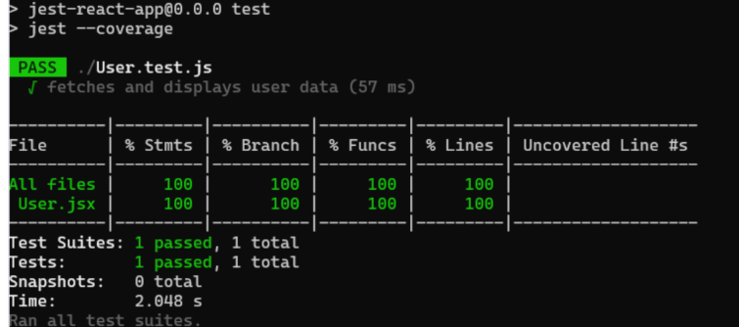
Integration Tests
Code Coverage
"scripts": {
"test": "jest --coverage",
// other scripts...
}

Slide 47
Integration Tests
Debugging
import {prettyDOM} from '@testing-library/dom’
const div = document.createElement('div’)
div.innerHTML = '<div><h1>Hello World</h1></div>’
console.log(div)

Slide 48
Integration Tests
Debugging
import {prettyDOM} from '@testing-library/dom’
const div = document.createElement('div’)
div.innerHTML = '<div><h1>Hello World</h1></div>’
console.log(prettyDOM(div))
// <div>
// <h1>Hello World</h1>
// </div>

Slide 49
Integration Tests
Debugging
const div = document.createElement('div’)
div.innerHTML = '<div><h1>Hello World</h1></div>’
// debug document
screen.debug()
// debug single element
screen.debug(div)

Slide 50
Integration Tests
Demo

Slide 51
V. End-to-End Testing

Slide 52
End-to-End Testing
Definition
End-to-end tests are like pretending you're a user and walking through everything they would do. It's about making sure the whole app works from start to finish, just like it should for a real user.

Slide 53
Integration Tests
Demo

Slide 54



Questions...

Slide 55
Thank you for your attention

